Slide 1
Code Styling
A brief rundown

Slide 2
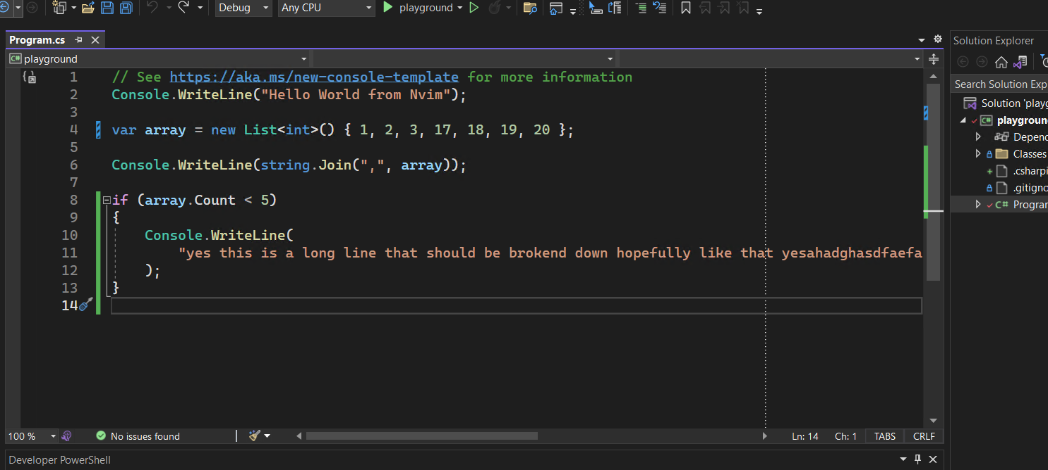
Line width

Slide 3
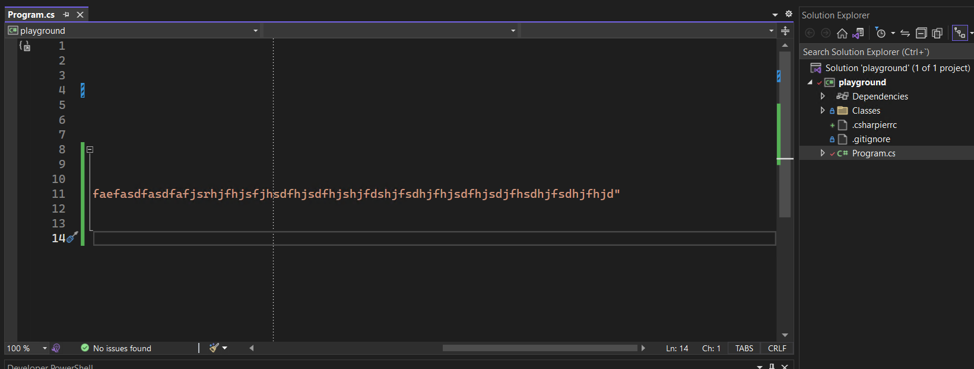
Line width

Slide 4

var people = new List<Person>
{
new() { Name = "John", Type = "Caucasian", Age = 21},
};

Slide 5

var people = new List<Person>
{
new() { Name = "John", Type = "Caucasian", Age = 21 },
};

Slide 6

var people = new List<Person>
{
new()
{
Name = "John",
Type = "Caucasian",
Age = 21
},
};

Slide 7

var people = new List<Person>
{
new() { Name = "John", Type = "Caucasian", Age = 21},
};

Slide 8
people
// .AsNoTracking()
.OrderBy(p => p.Name).Where(p => p.Type == "Hello" && p.Age > 20 || (p.Name == "Diego" || string.IsNullOrEmpty(p.Address))).OrderByDescending(p => p.CurrentTask);

Slide 9
people
// .AsNoTracking()
.OrderBy(p => p.Name)
.Where(p => p.Type == "Hello" && p.Age > 20 ||
(p.Name == "Diego" || string.IsNullOrEmpty(p.Address)))
.OrderByDescending(p => p.CurrentTask)
.Select(x => new
{
x.Address,
x.CurrentTask,
Hobbies = x.Hobbies
.Where(x => x.True)
.ToList(),
});

Slide 10
people
// .AsNoTracking()
.OrderBy(p => p.Name)
.Where(
p =>
p.Type == "Hello" && p.Age > 20
|| (p.Name == "Diego" || string.IsNullOrEmpty(p.Address))
)
.OrderByDescending(p => p.CurrentTask)
.Select(
x =>
new
{
x.Address,
x.CurrentTask,
Hobbies = x.Hobbies.Where(x => x.True).ToList(),
}
);

Slide 11
people
// .AsNoTracking()
.OrderBy(p => p.Name).Where(p => p.Type == "Hello" && p.Age > 20 || (p.Name == "Diego" || string.IsNullOrEmpty(p.Address))).OrderByDescending(p => p.CurrentTask);

Slide 12
DiegoB
people
// .AsNoTracking()
.OrderBy(p => p.Name)
.Where(p =>
p.Type == "Hello" && p.Age > 20 ||
(p.Name == "Diego" ||
string.IsNullOrEmpty(p.Address) && true))
.OrderByDescending(p => p.CurrentTask)
.Select(x => new
{
x.Address,
x.CurrentTask,
Hobbies = x.Hobbies
.Where(x => x.True)
.ToList(),
});

Slide 13
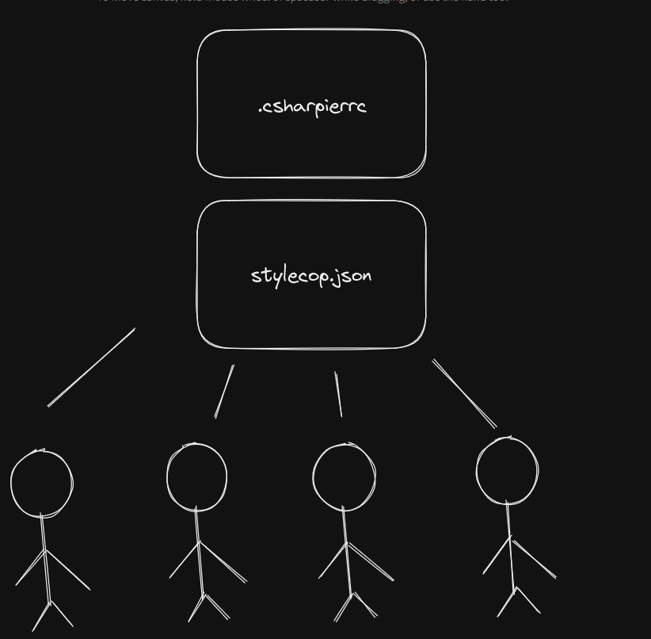
Config files

Slide 14
References
CSharpier. (n.d.). Retrieved February 27, 2023, from https://csharpier.com/docs/Configuration
DotNetAnalyzers. (n.d.). StyleCopAnalyzers/documentation at master · DotNetAnalyzers/stylecopanalyzers. GitHub. Retrieved February 27, 2023, from https://github.com/DotNetAnalyzers/StyleCopAnalyzers/tree/master/documentation
Pissarra, R. (2022, October 12). Object calisthenics: Principles for better object-oriented code. Object Calisthenics. Retrieved February 27, 2023, from https://blog.avenuecode.com/object-calisthenics-principles-for-better-object-oriented-code
Rossum , G. van, Warsaw , B., & Coghlan, N. (n.d.). Python enhancement proposals. PEP 8 – Style Guide for Python Code. Retrieved February 27, 2023, from https://peps.python.org/pep-0008/

